Slide 1
Employment Dataset Project Storyboard
By Gavin Gunawardena

Slide 2
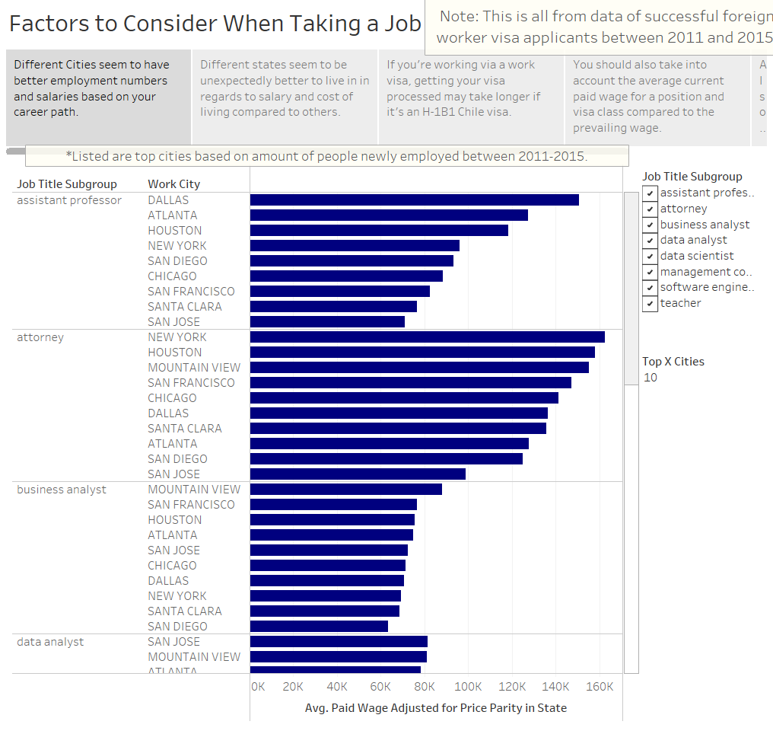

Slide 3
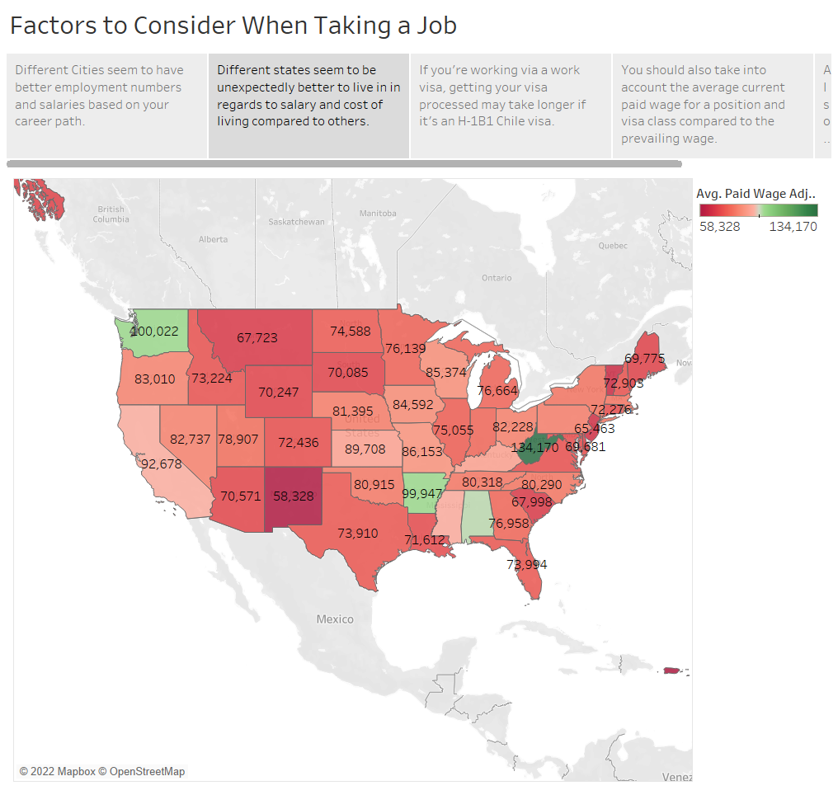

Slide 4
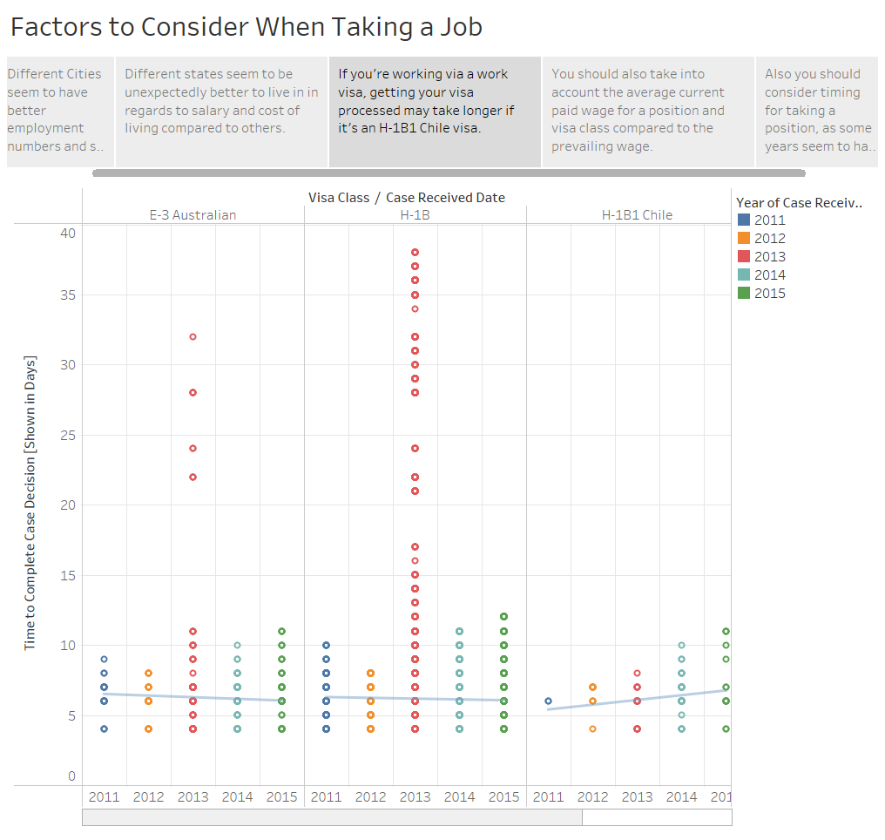

Slide 5
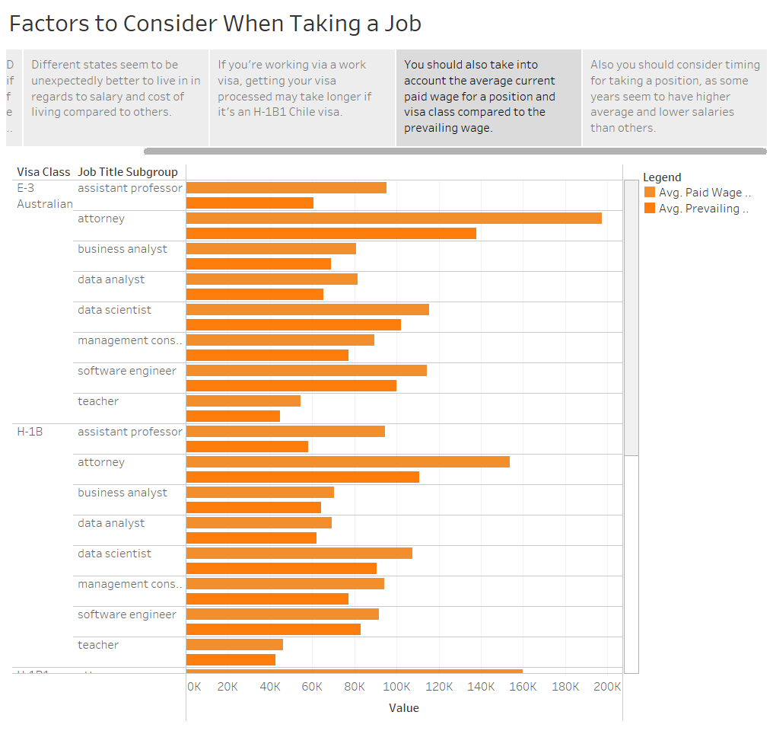

Slide 6
